Slide 1
SyriaTel Customer Churn Prediction
By Arsh Patel

Slide 2
Business Understanding
Stakeholder
SyriaTel - A telecommunications provider
Business Problem
Want to know if customer churn (if they leave) is predictable and
what features are correlated with customers leaving
Our solution
Random Forest Model ~ 96% accuracy
Data
Dataset of 3300 customers

Slide 3
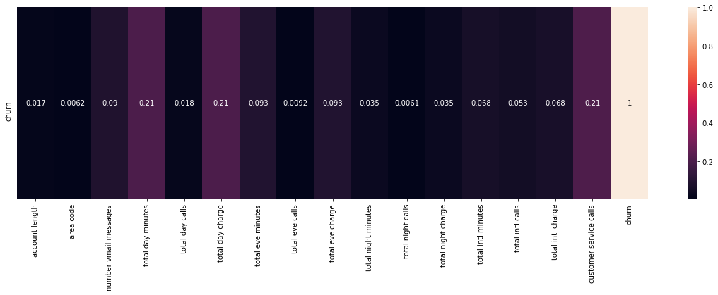
Customer Churn Correlation Heatmap

Slide 4
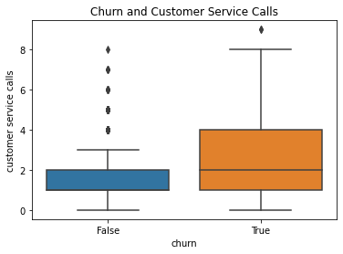
Most Predictive Features
Customer service calls

Slide 5
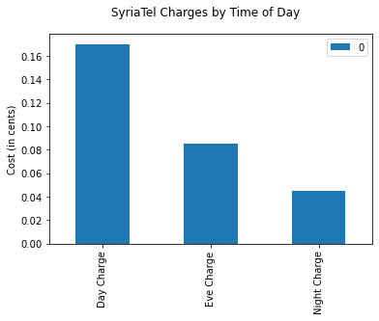
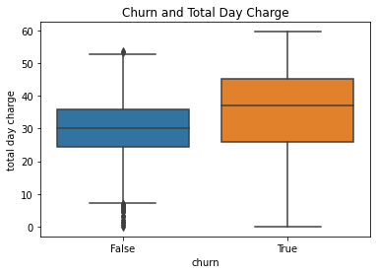
Most Predictive Features
Total Day Charge + Total Day Minutes

Slide 6
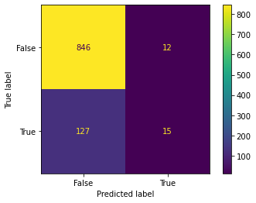
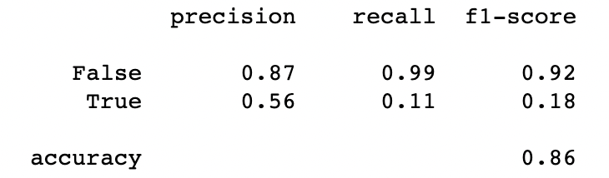
Baseline Model
First model - Logistic Regression
Accuracy is overall high = 0.86
BUT
Poor Predictor
15 / 142 = ~11%

Slide 7
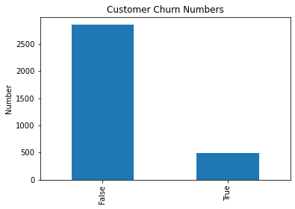
Making A Better Model
Addressing the Class Imbalance
Low amount of customers
leave
Look at Categorical Information
Area Code and State

Slide 8
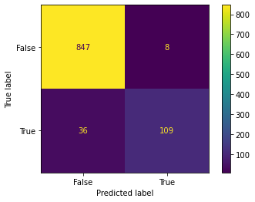
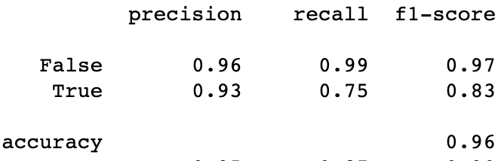
Final Model
Final Model - Random Forest
Accuracy is higher = 0.96
AND
Improved Predictor
109/ 145 = ~75%

Slide 9
Model Comparison
Baseline Final

Slide 10
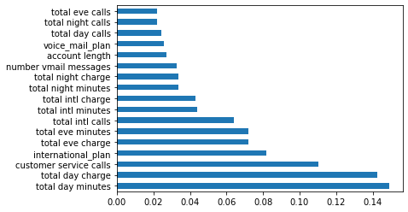
Feature Importance in Final Model

Slide 11
Recommendations
To prevent customers leaving:
Improve quality / number of customer service representatives
Reduce price of phone charges during day

Slide 12
About Me
Arsh Patel
Email: arsh.j.patel@gmail.com
Linkedin: https://www.linkedin.com/in/arsh-patel-a4725220a/

